Slide 1
Pipelined CPU Design With FPGA in Teaching Computer Architecture
Prepared by:
Jason khadka
Sajan dawadi
Suvrat ghimire
Nabin shresha tamang
Aashish dhakal

Slide 2
Abstract
Research paper by Jong Hyuk Lee, Seung Eun Lee, Heon Chang Yu, and Taeweon Suh.
Pipelined CPU design with FPGA system
5 staged pipelined 32-bit MIPS design

Slide 3
Introduction to key terms
What is FPGA?
Altera DE 2 board
MIPS (microprocessor without interlocked pipelined stages)
Single cycle MIPS
Pipelined CPU design
HDL

Slide 4
Related Work
Teaching computer architecture courses, with most of studies adopting architecture simulators.
Djordjevic created an educational environment known as CAL2,where students can exercise assembly programming, monitor program execution, and inspect implementation details at the register transfer level.
Nikolic surveyed and evaluated simulators suitable for teaching computer architecture course.
Oztekin introduced architecture simulator called BZK.SAU.
Gustin developed a processor referred to as “Move” and proposed implementing a CPU downloadable to an FPGA.
Bulic et al. [1] also introduced an FPGA-based environment, based on their own HIP processor, which implemented a five-stage pipelined processor.
.

Slide 5
Different papers were published to improve teaching and adopted various pedagogical methods: PBL, experiential learning and incremental learning .
Linge reports their experience of using PBL for teaching computer network design.
Ozturk describe experiential learning with simulation for a project-oriented multicore education.
Schaumont introduced a senior-level course using an incremental design approach for a hardware and software codesign.

Slide 6
The adoption of incremental learning has been driven by the following benefits .
It is useful for students whose upfront experience is limited, compared to that of professional engineers.
A course using incremental learning is likely to be perceived as easier than one in which many weeks of background introduction are required before students can attempt practical exercises.
It avoids the fault line between prior knowledge and new knowledge that students can experience in the middle of courses with longer timescales.

Slide 7
The project described here requires the actual implementation of the 32-bit MIPS rather than using simulators or just experimenting with ready-made complete CPU models.
Students are able to build their practical knowledge and skills in computer operation and design.
Students can use an open-source off-the-shelf MIPS compiler since the project targets a commercially successful MIPS.
Students can instantly examine the operation of the designed CPU visually with their own software thanks to the system model and the FPGA system.
The number of assigned instructions was minimized to lessen the burden of implementation while maximizing the educational efficiency.
The project combines three pedagogical methods: PBL, hands-on learning, and the incremental approach

Slide 8
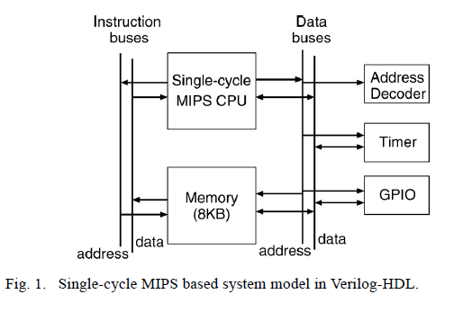
1.Hardware Model of the MIPS-Based System
What is MIPS?
For experiments on the DE2 board, a simple model of a computer system was devised as shown in Fig. 1.

Slide 9
The model, composed of five components:
Single-cycle MIPS CPU
Memory
Address Decoder
Timer
General Purpose Input/Output (GPIO)

Slide 10
Using the system model, user can turn on and off seven-segment displays
LEDs and take input from switches and push-buttons on the DE2 board by writing simple MIPS assembly and/or C code.
Why was 32-bit MIPS was chosen as a target CPU?
From where the single-cycle MIPS design came?
It only implements a subset of the MIPS instructions, as listed in Table I.
Because of that it is hardly able to execute even a simple C program
The critical path is much longer than the pipelined CPU, limiting the operating clock frequency
The main goal of this project is to add new instructions and convert the single-cycle CPU to the pipelined version.

Slide 11
The system model should be downloaded to an FPGA on the DE2 board
Because of that memory is created with Megafunction in Quartus-II instead of using a generic Verilog model
The Megafunction creates the user-configured memory with memory elements inside the FPGA
. There is a dual-port memory, one port for accessing instructions and the other for accessing data
It was created to allow for two simultaneous accesses from the CPU, avoiding the structural hazard
The memory is preloaded with the compiled MIPS binary and merged into a bitstream, downloadable to the FPGA
The components were designed from scratch using Verilog-HDL except the single-cycle MIPS and memory

Slide 12
What is Timer and what it does?
The timer is an essential component in virtually any digital system
Its major role is to periodically notify the system of an event, so that the system can properly manage resources and tasks
The timer in Fig. 1 has a internal counter and can generate an interrupt periodically according to the counter value set by a user.

Slide 13
What is GPIO module and what is it used for?
GPIO is a module for interacting with the external world
By programming the GPIO module, students can take input from switches and push-buttons on the DE2 board
By using the taken input we can display numbers on seven-segment displays, and turn on/off LEDs

Slide 14
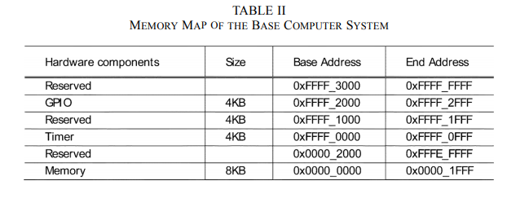

Slide 15
Table II shows the memory map of the system model, which has a 4-GB memory space since the implemented MIPS has a 32-bit address bus
Each peripheral device occupies a 4-kB space
But the whole 4 kB is not completely consumed by its internal registers
The address decoder in Fig. 1 assigns a memory space to each peripheral device in the system. Since the source code is based on Verilog-HDL
students can easily change the memory map and perform experiments with assembly and/or C-programming if desired

Slide 16
2.Software Environment
The Eclipse Integrated Development Environment (IDE) is used for the software development
The Eclipse provides a convenient environment for programming, so it is widely used in both academia and industry. Once software is written using assembly and/or C-language
The MIPS cross-compiler generates a binary file in the Executable and Linkable Format (ELF)
Since the Megafunction-generated memory requires a special file format—Memory Initialization File (MIF)—for initialization, a Perl script was written to convert the ELF binary file to the MIF format
As the name implies, the MIF is used to initialize the memory in Altera FPGA, preloading a software program into the memory in Fig. 1.
To automate the compilation to the MIF conversion process, the make utility is used with Cygwin under Eclipse.

Slide 17
3.Experiment Environment

Slide 18
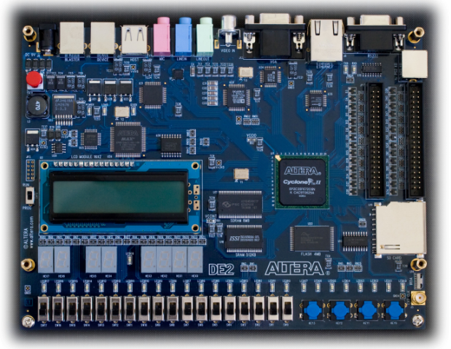
Fig. 2. Altera DE2 board

Slide 19
The main component in this board is a Cyclone-II FPGA, to which a software program downloads the hardware system model.
The board features various input and output components such as switches, push-buttons, seven-segment displays, a serial port, LEDs, and USB connector
Altera provides a CAD tool, Quartus-II, which is used to synthesize, place and route, and download the logic design to the Altera FPGAs
The MIF is merged with the hardware design, and the generated bitstream is downloaded to the Cyclone-II from a PC via the USB connection.

Slide 20
Pipelined 32 bit mips design
Total work was done in 7 milestones as designed by the developers
Most time spent on single cycle MIPS
Then finally upgraded to pipelined MIPS
Explained in the table below

Slide 21
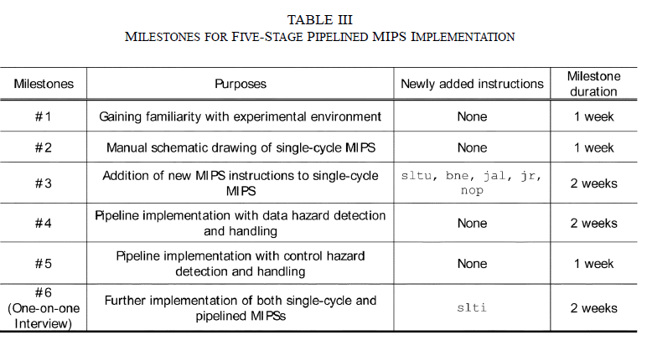

Slide 22
COMPUTER ARCHITECTURE CURRICULUM
Table V summarizes the curriculum devised for the computer architecture course.
The prerequisite courses to take this course are C-programming and Computer Logic Design.
The Computer Logic Design course is offered in the Spring semester before the Fall semester offering of the computer architecture course and covers digital logic design and Verilog-HDL.
Thus, students are prepared to design any digital logic, including CPU, if guided properly.
As shown in Table V, the 16 weeks of lectures include MIPS instructions, single-cycle MIPS design, pipelined MIPS design, caches, TLB, and I/Os.

Slide 23
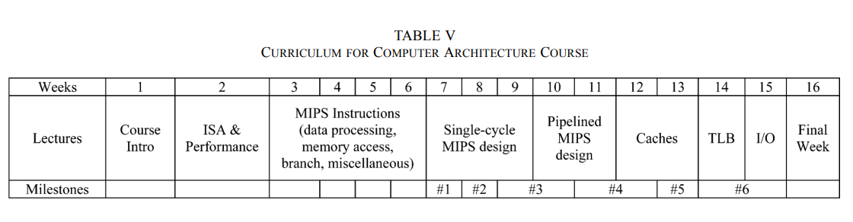

Slide 24
Course evaluation and survey
Same project was given to fall semester of 2009 and 2010
Only difference was 2009 student used model-sim and 2010 students used FPGA and milestones were adopted
A sample paired t test was conducted to see the effectiveness of this implementation
Following datas were obtained

Slide 25
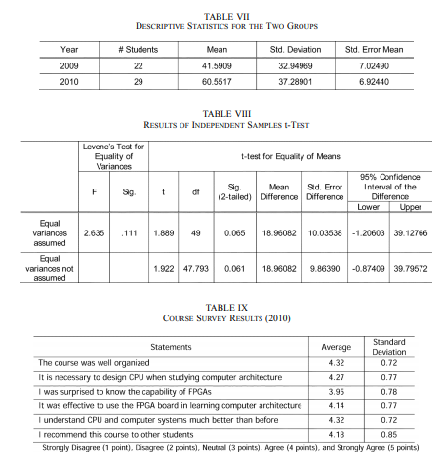

Slide 26
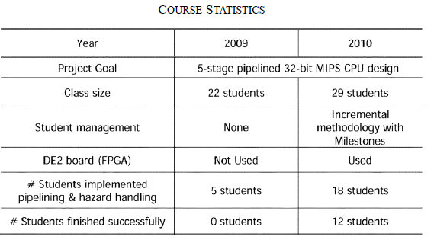
The test concluded that means of the two groups were significantly different in favor of 2010 so the implementation turned out to be effective

Slide 27
Conclusion
Thus the 5 staged pipelined MIPS was built
limited instruction were implemented to reduce complexity
Proved to be more effective as shown by the stats.

Slide 28
Thank you!!!!

